Slide 1


Company Name and Logo
Your Company
Cybersecurity Training
Protect yourselves online by mastering cybersecurity
best practices
Week 4
www.YourCompany.com
Notes:
This will be the final session of your employee cybersecurity training.
Show this training slide before the training.

Slide 2



Let's Review
Social Engineering
Mobile Device Security
Notes:
Ask the staff: "Let's see what you have remembered from last week... who can tell me something about... "
Depending on how much you have, you will ask them about the concepts below. If a concept is not clear, refresh their memory before moving on.
A - Social Engineering
1. Point of Entry
2. Social Media
3. Types of Attack
4. Techniques
5. Countermeasures
6. Prevention
B. Mobile Device Security
1. Software updates
2. Passwords
3. Biometric authentication
4. Security software
5. Public Wi-Fi
6. Third party apps

Slide 3


What will we be discussing
Social Media and Web Browsing Safety Guidelines
Cybersecurity Incident Reporting
Notes:
Let them know the topics that we will be covering this session.
I. Social Media and Web Browsing Security
II. Cybersecurity Incident Reporting
*Be sure to interact with them and make it engaging**

Slide 4

Social Media and Web Browsing Safety Guidelines
Notes:
This slide will be the indicator for the next first section covered today.

Slide 5

Social Media Safety
Protect Personal Information
Limit Personal Information
Avoid Sensitive Information
Strong Passwords
Notes:
Discuss and tell them some important tips and reminders on staying safe online, especially with Social Media.
Here the discussion will be about protecting personal information.
I. Social Media Safety
A. Protect Personal Information
1. Limit the amount of personal information shared on social media
2. Avoid sharing sensitive information such as home address, phone number, or financial information
3. Use strong, unique passwords for social media accounts

Slide 6
Social Media Safety
Be aware of scams and malicious content
Be aware of unsolicited messages
Avoid suspicous links
Use an up-to-date anti-virus
Notes:
Continue the discussion and let them know that scams and malicious are prevalent in Social Media.
Here the discussion will be about being aware of scams and other dangerous content.
I. Social Media Safety
A. Be Aware of Scams and Malicious Content
1. Be cautious of unsolicited messages, especially from unknown sources.
2. Avoid clicking on suspicious links or downloading unknown files.
3. Use up-to-date antivirus software to protect against malware.

Slide 7
Social Media Safety
Manage Privacy Settings
Be familiar with privacy settings
Customize privacy settings
Review regularly
Notes:
Continue the discussion and on social media safety.
The discussion will be about managing privacy settings.
I. Social Media Safety
A. Manage Privacy Settings
1. Familiarize yourself with the privacy settings of social media platforms.
2. Customize privacy settings according to personal preferences.
3. Regularly review and update privacy settings.

Slide 8
Web Browsing Security
Use secure browsers
Chrome, Microsoft Edge, Mozilla Firefox
Keep browsers updated
Notes:
In this next section, let them know we will discuss securing themselves when browsing the internet.
The following will be some pointers to use.
II. Web Browsing Safety
A. Use Secure Browsers
1. Use browsers with built-in security features like Google Chrome or Mozilla Firefox.
Avoid browsers that you have just heard of or are not familiar with.
2. Keep browsers updated to ensure the latest security patches are installed

Slide 9
Web Browsing Security
Be cautious of Phishing scams
Do not click on unknown links
Check the authenticity
Use anti-viruses and firewalls
Notes:
In this next section, we will continue discussing web browsing security.
II. Web Browsing Security
A. Be Cautious of Phishing Scams
1. Do not click on links or download attachments from unknown or suspicious sources.
2. Check the authenticity of websites before entering personal information.
3. Use anti-virus software to prevent phishing attacks.

Slide 10
Web Browsing Security
Use strong passwords
Strong and Unique Passwords
Password manager to generate strong passwords
Two-factor authentication
Notes:
In this next section, we will continue discussing web browsing security.
Having secure passwords. This is also a constant reminder to them to always use secure passwords, whether they are online or not.
This section is a good review of what was previously discussed.
II. Web Browsing Safety
A. Use Strong Passwords
1. Use strong, unique passwords for each online account
2. Use a password manager to store and generate strong passwords
3. Enable two-factor authentication for added security

Slide 11
Web Browsing Security
Avoid Public Wi-Fi
Avoid when banking or shopping
Use a VPN (virtual private network)
Notes:
In this next section, we will continue discussing web browsing security.
Securing themselves when using public Wi-Fi or avoid them.
II. Web Browsing Safety
D. Avoid Public Wi-Fi - Let them know that a lot of people used public Wi-Fi and it exposes their information even more.
1. Avoid using public Wi-Fi networks for sensitive activities such as online banking or shopping
2. Use a virtual private network (VPN) when using public Wi-Fi to encrypt internet traffic

Slide 12
Incident Reporting
Notes:
Let the attendees know that the next topic will be the importance of reporting a security incident and how to submit one.
Let them know that this will be internal only to the company.
They should report critical events that they suspect.

Slide 13
Incident Reporting
Reasons to submit a report
Identify the root cause
Prevent further damage
Help Investigation
Compliance and legal requirements
Notes:
Explain to the attendees the importance and reasons for submitting an incident report.
I. Reasons to submit a cybersecurity incident report
A. Identify the root cause of the incident
B. Prevent further damage
C. Help in the investigation process
D. Compliance with legal and regulatory requirements
Protect the organization's reputation.

Slide 14
Incident Reporting
Best Practices
Identify the root cause
Prevent further damage
Help Investigation
Compliance and legal requirements
Notes:
Explain to the attendees some of the best practices when submitting a cyber-security incident report.
I. Best practices for submitting a cybersecurity incident report
A. Report the incident immediately
B. Provide clear and concise information
B. Follow established reporting procedures
Involve the relevant stakeholders
C. Maintain confidentiality

Slide 15
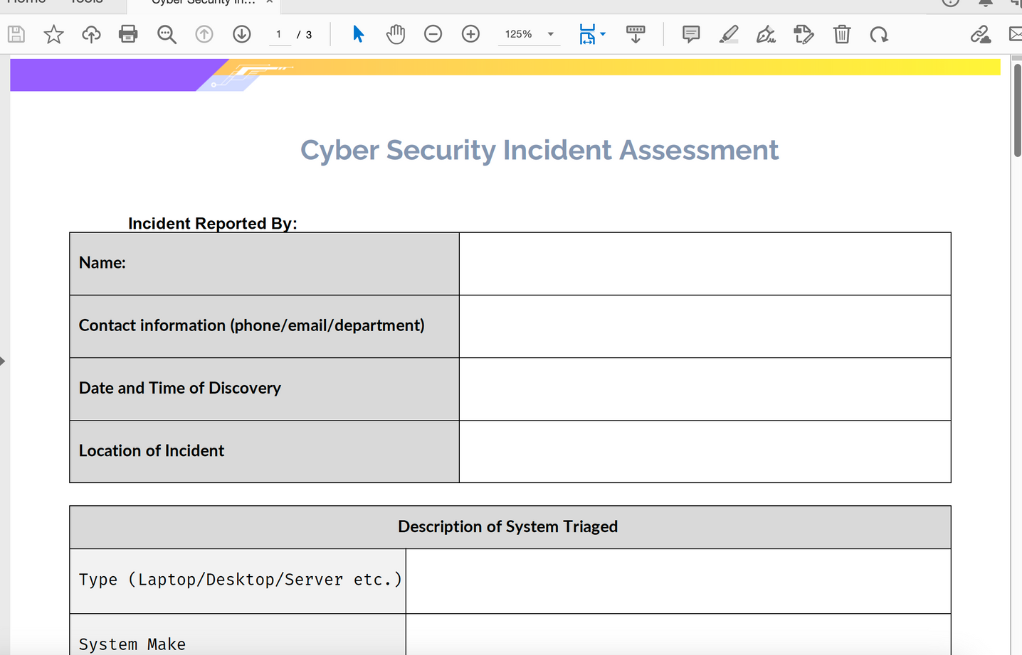
Incident Reporting
Form to submit
Notes:
Explain the procedure in reporting a cybersecurity incident.
In the template folder provided, an incident report form is included.
Please feel free to make changes to this form and use it at your company to report any cyber security incidents.
Be as detailed as they can.
Provide them with the contact information of who to submit this incident report.

Slide 16
Security Policy
Notes:
In this final section, discuss the security policy your company has or its intention to implement.
Let them know what a security policy is, which are guidelines for interacting with your company's network and systems.
Provide your employees with a print or digital copy of the security policy if available.

Slide 17
Questions
Notes:
Ask the training attendees if they have any questions that need to be addressed.
Open this section for interactive discussion.
Review any details they wish to be reviewed.

Slide 18
Recap and Takeaways
Notes:
Review what the attendees have understood and ask around what they have learned.
Asking around reinforces what they have learned, in which they can also teach others.

Slide 19
Congratulations
Notes:
Congratulate everyone for completing this session.
Also, remind them to begin using what they learned and to be safe when going out into the digital space.

Slide 20

Company Name and Logo
Thank you
for your attention
www.YourCompany.com
Notes:
Thank the attendees and congratulate them on their completion.
Let them know to review the materials provided and that they can ask questions after this training session.

